Slide 1

HIPAA Compliance Features for Healthcare Applications
Ensuring Privacy and Security of Protected Health Information (PHI)

Slide 2
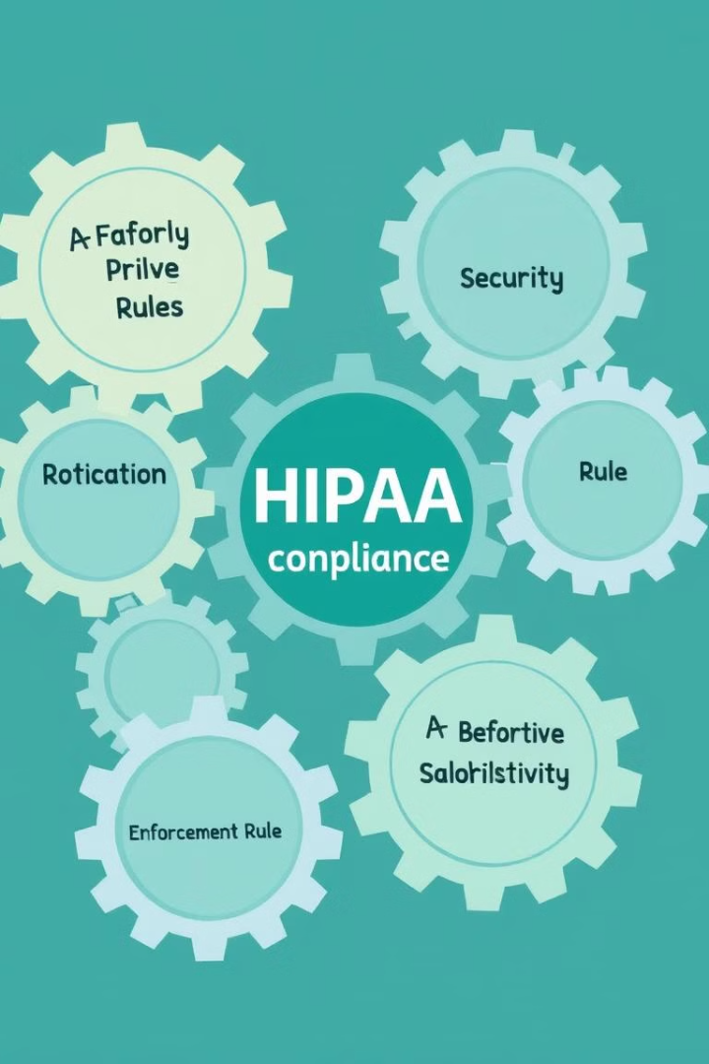
Agenda
1
Authentication & Access Control
2
Encryption & Secure Communication
3
Audit Logging & Monitoring
4
Data Retention & Disposal

Slide 3
Authentication & Access Control
User Authentication: multi-factor authentication, strong password policies
Role-based Access Control: Limit access based on job roles and responsibilities

Slide 4

Encryption & Secure Communication
Encryption at Rest & In Transit: AES-256 encryption for data storage, TLS/SSL for secure transmission
Secure Messaging & Email: End-to-end encryption for in-app messaging, S/MIME or PGP for email encryption

Slide 5




Audit Logging & Monitoring
Audit Trails
Real-Time Monitoring
Log Retention
Track and log all user interactions with PHI
Detect unauthorized access or abnormal activity
Keep audit logs for at least 6 years to comply with HIPAA

Slide 6
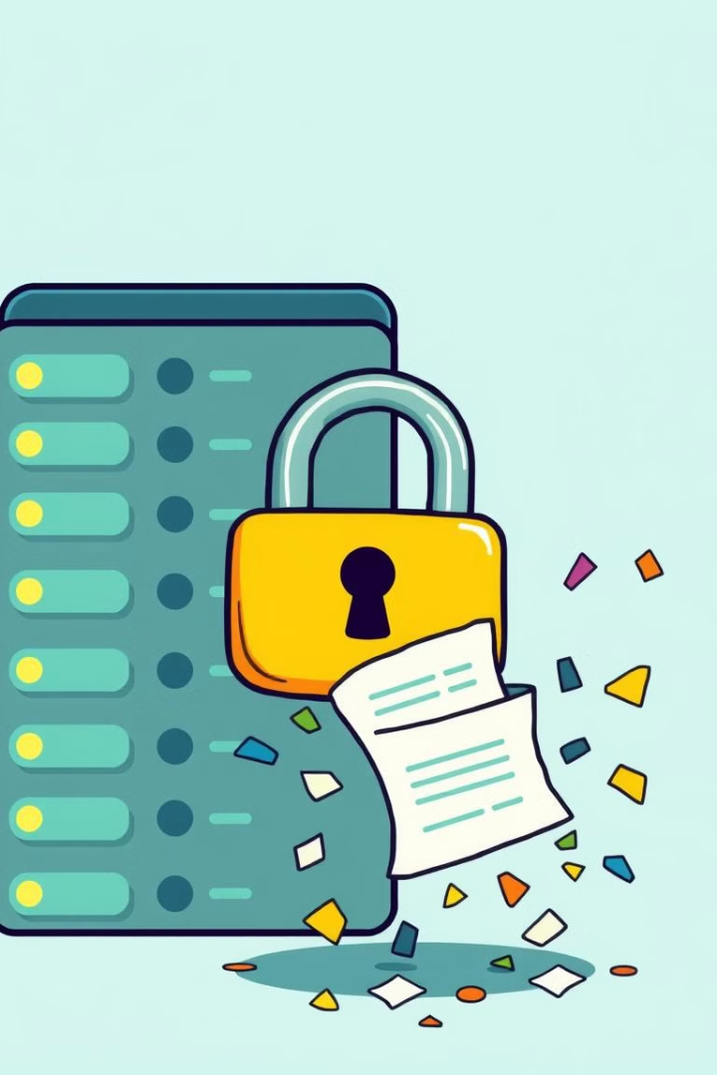
Data Retention & Disposal
1
Data Retention Policies: Retain PHI only for the required period by HIPAA
2
Secure Disposal: Implement automated secure deletion of PHI after retention period
3
Backup and Recovery: Regular encrypted backups and disaster recovery plans for PHI

Slide 7




Consent Management & Patient Rights
Patient Consent: Obtain and store patient consent for sharing PHI
Access & Correction: Allow patients to access and request corrections to their PHI
Data Portability & Restriction: Enable secure data export and patient restrictions on PHI use

Slide 8



Incident Response, Remote Access & Privacy by Design
Incident Response & Breach Notification
1
Detect breaches, notify affected parties, and report to HHS within 60 days
Secure Remote Access
2
Use VPNs and Mobile Device Management (MDM) for secure remote access
Privacy by Design
3
Collect only necessary PHI and ensure security is enabled by default

